Slide 1
Lets go to Hawaii!
Group 5: Ben, Cameron, Tongchen, Tien, and Josh

Slide 2
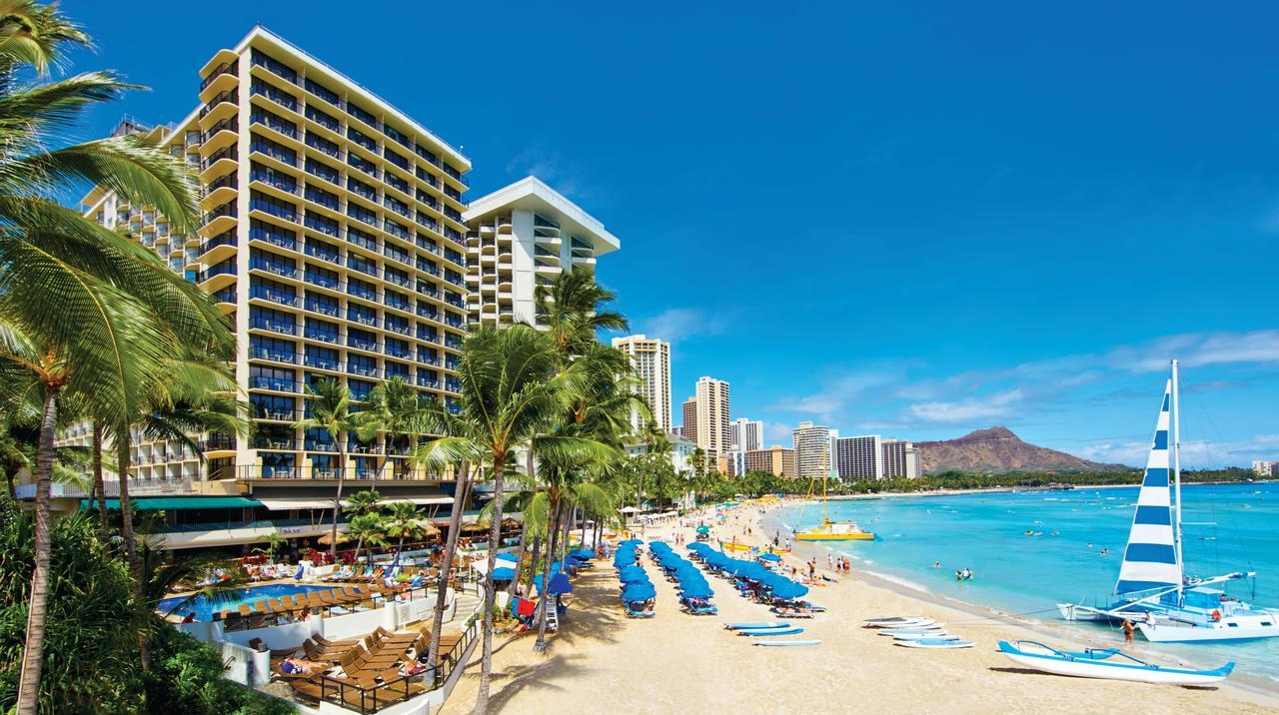
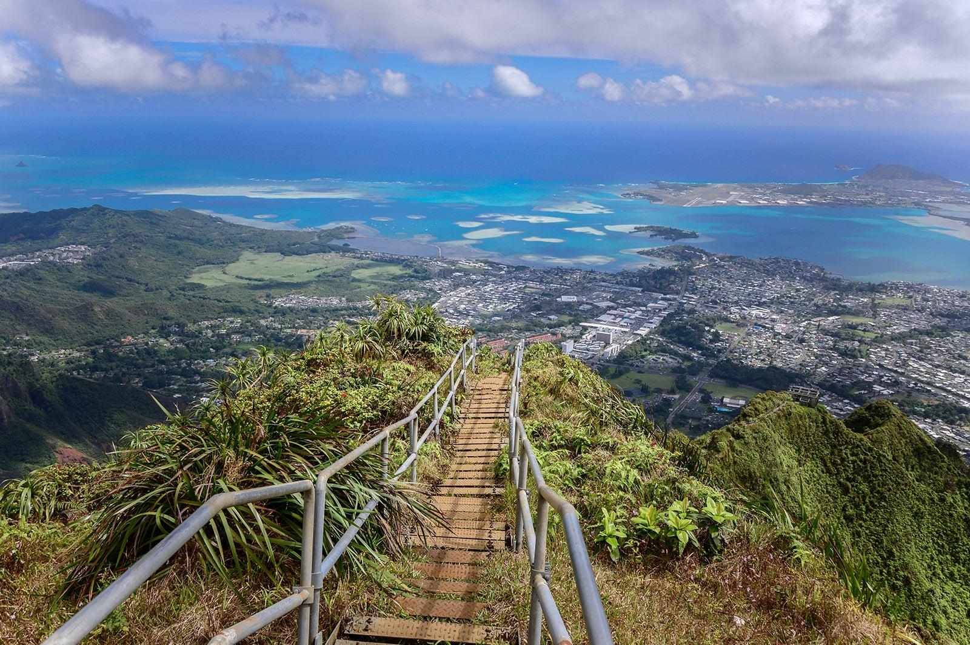
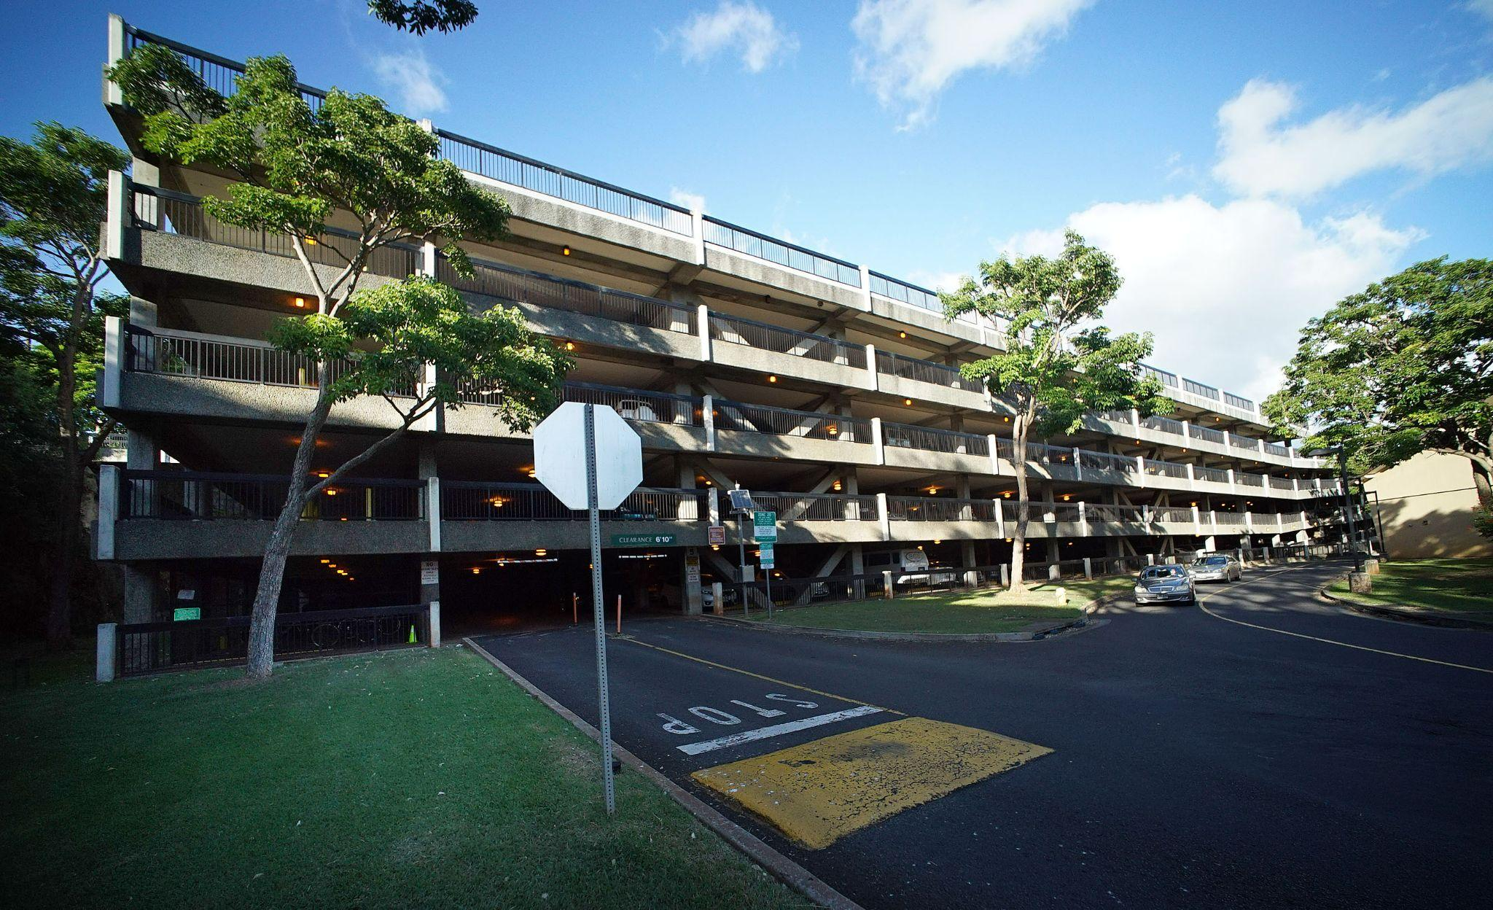
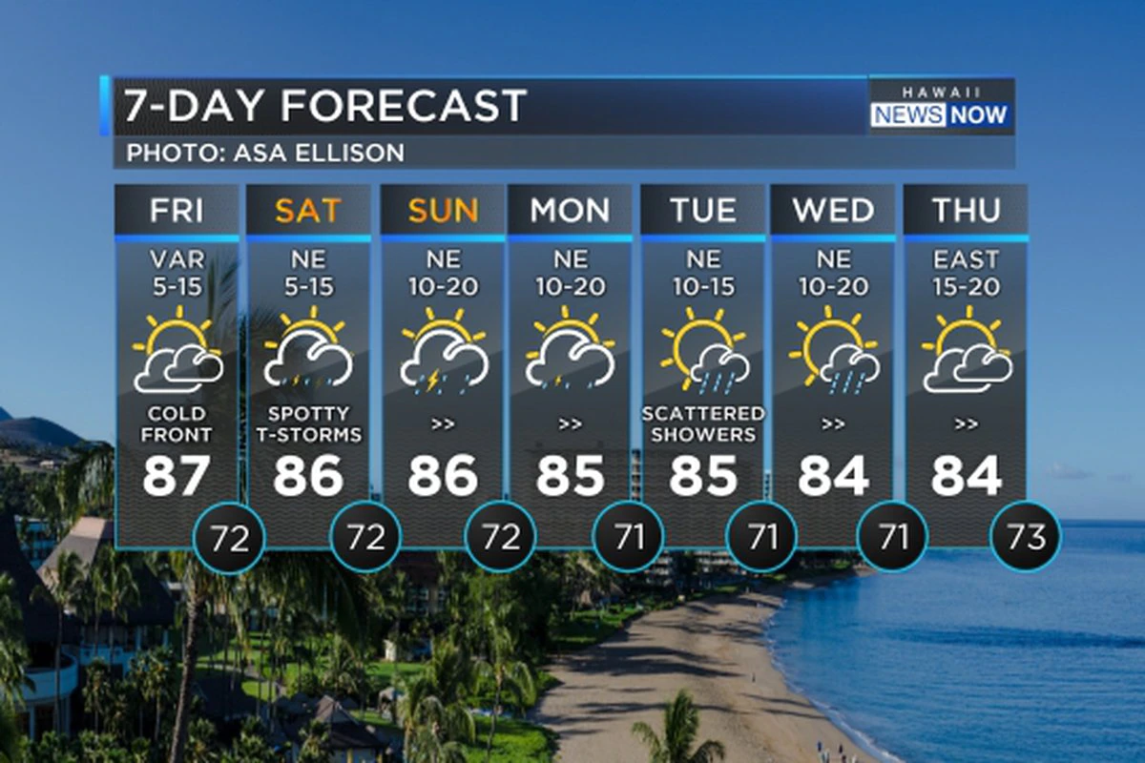

Slide 3
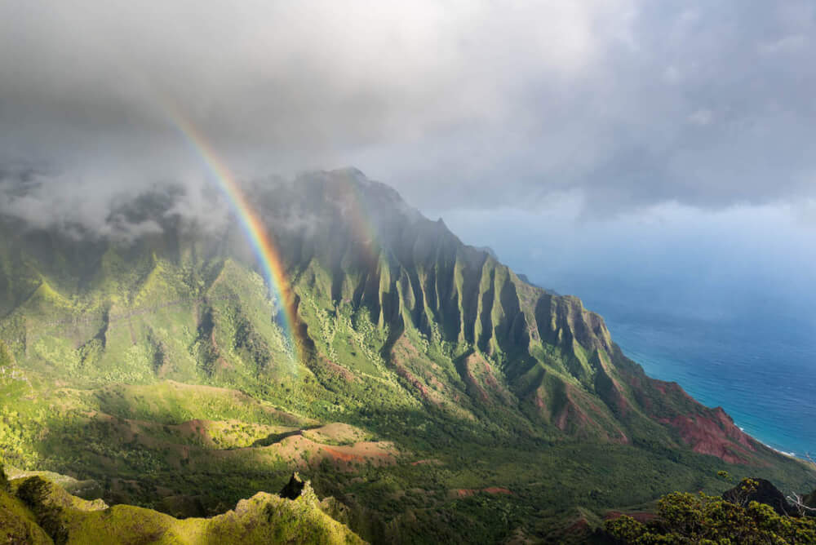
Concern of rainfall when visiting Hawaii
What is a good month to visit Hawaii to avoid monsoon and rainfall?
Is the temperature related to a rainfall?

Slide 4
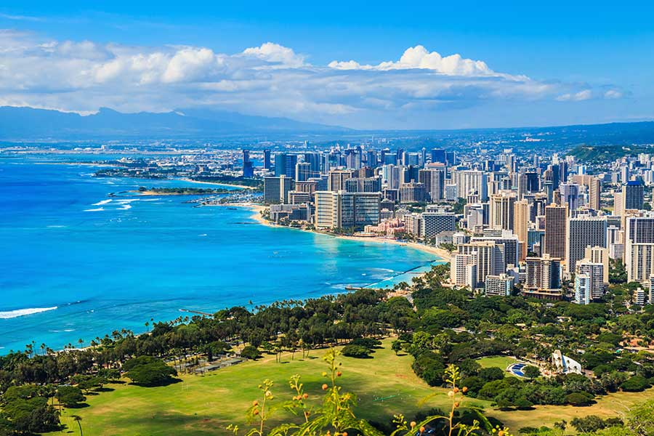
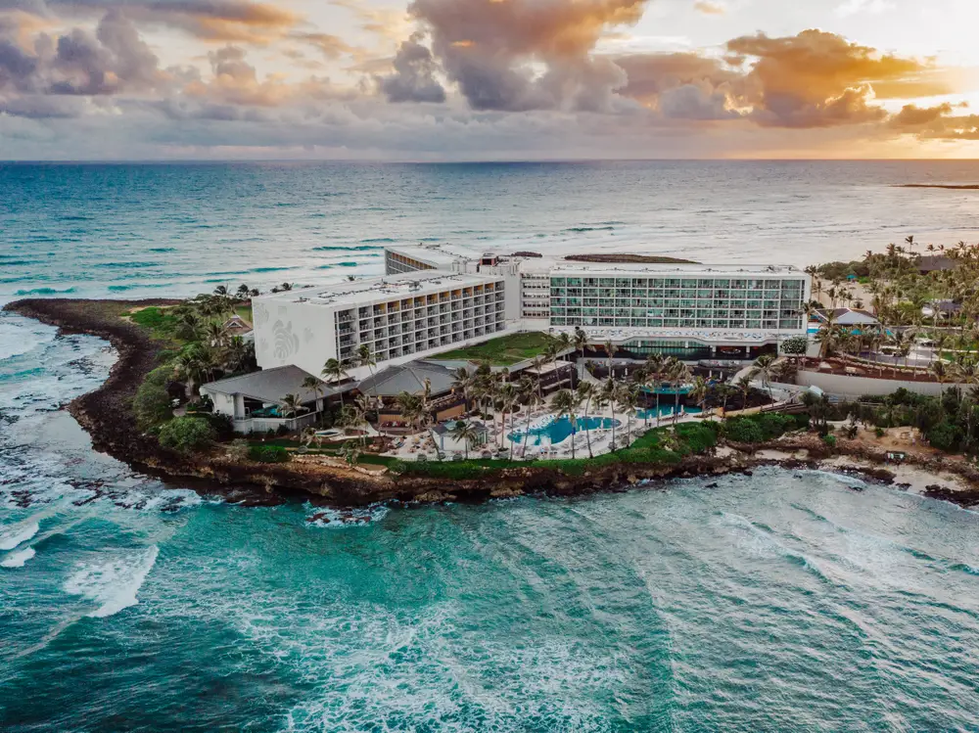
Where will we stay?
-Hotel accommodations is an important factor in a long stay on the islands.
- Are the locations nearby parkings? Trails? Other attractions?

Slide 5
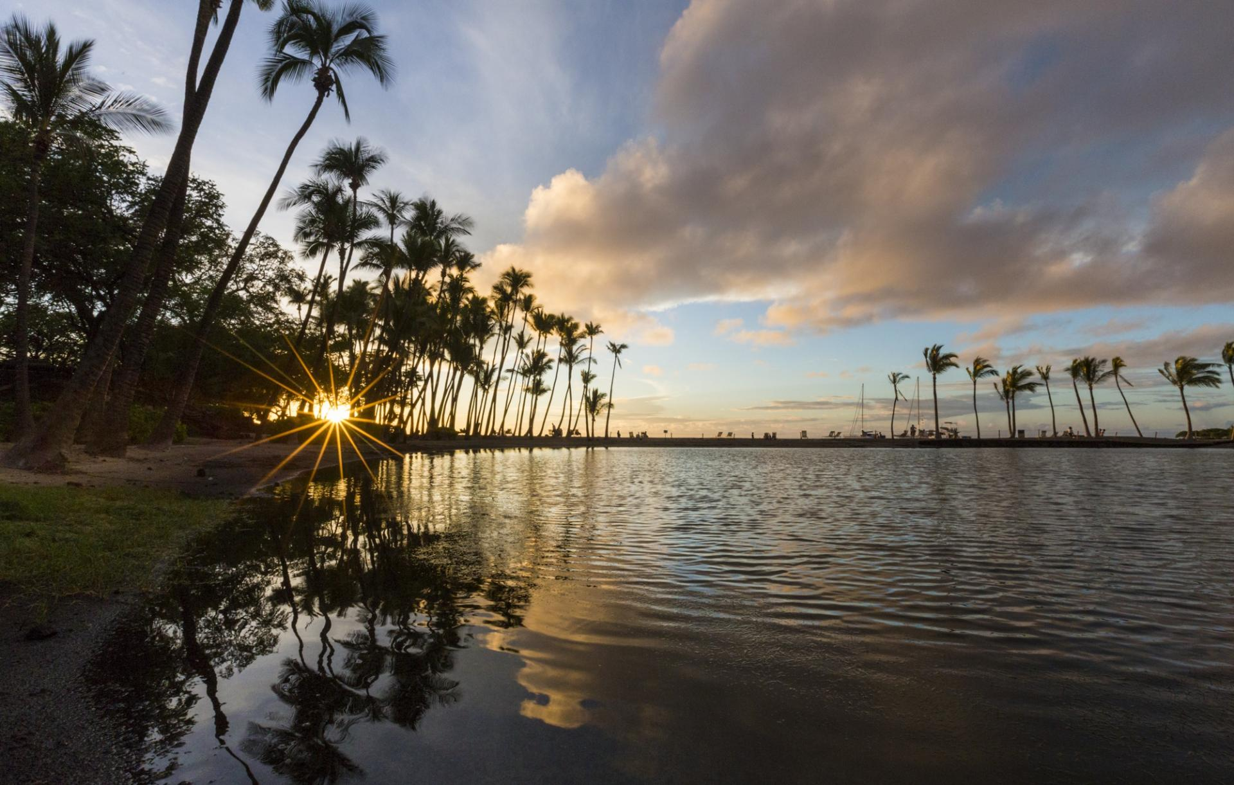
Hawaii weather
Which cities with a cold temperature that we should avoid visiting?
Which city in Hawaii are the cloudiest?
Which cities are windy?

